Slide 1
Week 1 CIS 215
Introduction and Threat analysis

Slide 2
Ethical Considerations
Ethical Hacking - https://www.eccouncil.org/ethical-hacking/
Why have Ethical Hacking?
Why we need to see from a Black Hat point of view to protect
Example of a burglar tossing a room
Security+ vs Certified Ethical Hacking

Slide 3
Activity Ethical Discussion
Option 1 – As you go about your Pen test of a company, you notice a massive breach for both customers and employees. You find significant data is out on Pastebin including SS# for a couple employees, do you stop the pen test to inform the company? Keep going because you know you'll find more and the good of many out weighs the few?
Option 2 – Resource allocation, if a non-profit can afford to make a medical device (pacemaker, insulin pump) but they don't have budget for a security professional should they still make the device? What if they are sharing it with low income people who couldn't afford one otherwise but they want wi-fi included?

Slide 4
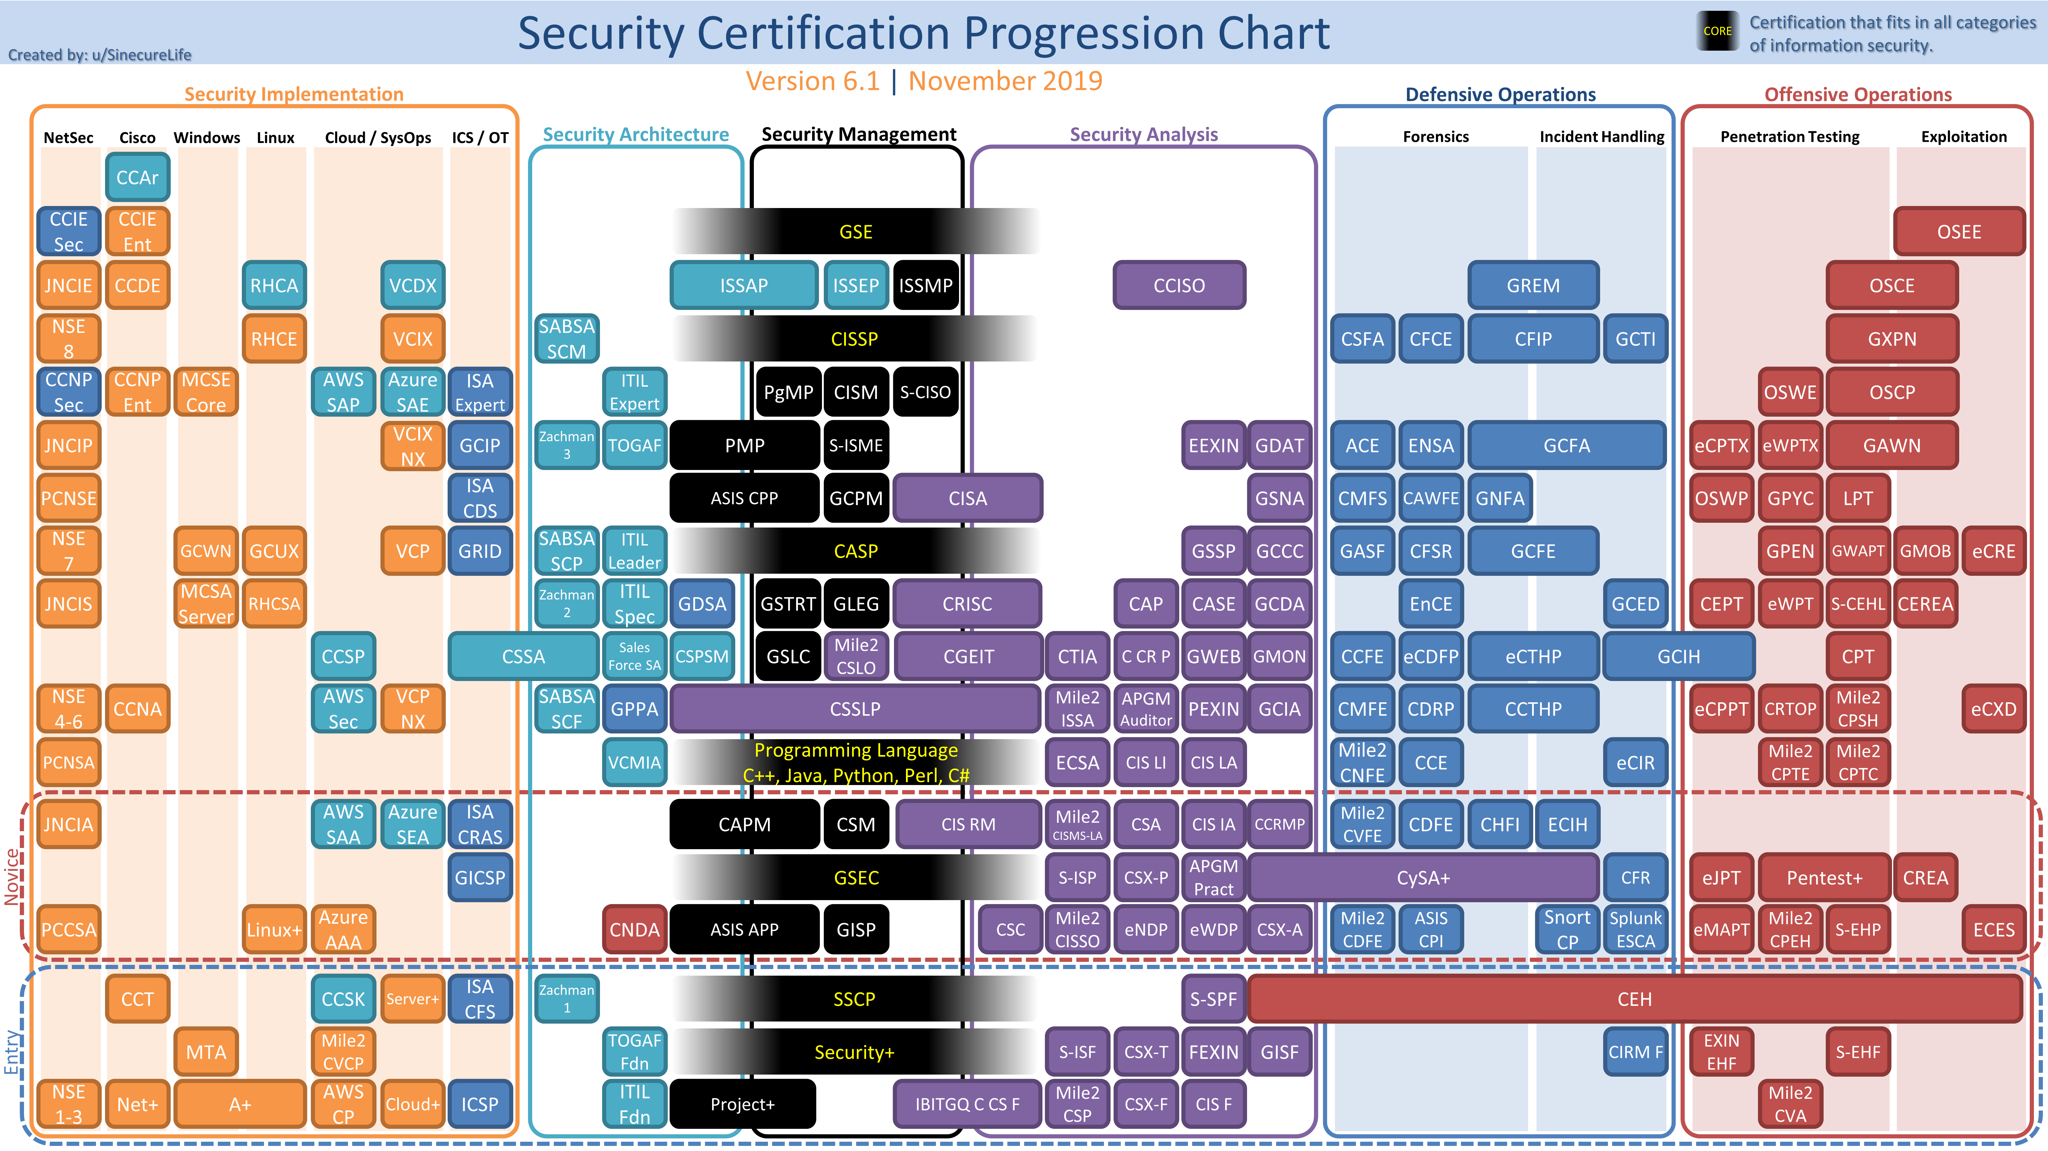
https://www.reddit.com/r/cybersecurity/comments/e23ffz/security_certification_progression_chart_2020/

Slide 5

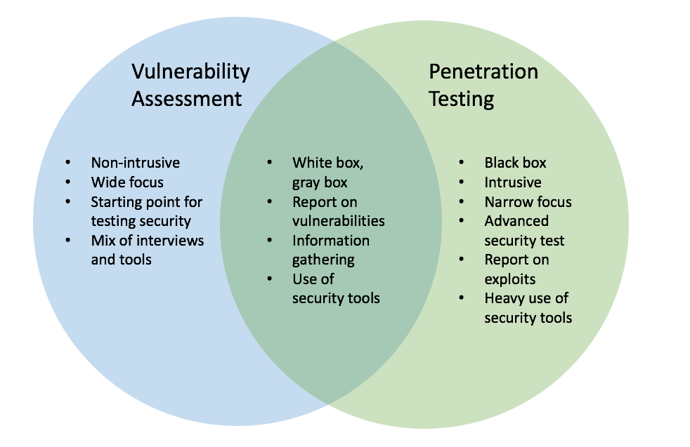
Vulnerabilities
Threat assessment
How serious is the threat?
What can be lost if it's exposed? (Trade secrets? Unimportant info?)
How likely is it to be exposed?
Different vulnerabilities are exposed in different ways
Internal knowledge (red/blue team) sees differently than an outside pen test, which are both different then an audit

Slide 6
Red vs Blue vs Purple
Red Team
Attack - Emulate the adversary
Needs to be somewhat lawless since they need to be pretend bad people
Blue Team
Defense – try to keep company safe from attackers
Purple Team
Red and Blue cooperate
Goal of Purple team is communication between red and blue
Not necessarily a separate team

Slide 7
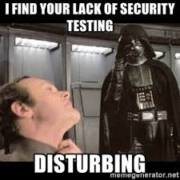
Security Audits
Looking through security policies for vulnerabilities
Usually with internal cooperation
Looks at best practices
Documentation of policies, teams and behaviors

Slide 8
Pen Testing – Ethical Hacking
Penetration test is from the outside in
Usually outside contractor
Internal offense/defense would be
Red team vs blue team
Purple team
Snapshot in time
Vulnerabilities found aren't guaranteed to always be there, just what was found when testing was done
Re-Assessments usually needed, can be yearly
Needs authorization, paperwork and proper signatures
Can have Legal Issues!

Slide 9
Pen testing – Rules of Engagement
Who can say yes? Under who's authority is this being undertaken?
Is the scope VERY clearly spelled out?
When is the test?
Who is doing the test, what info can be shared, and what is turned in at the end?
Who needs to be notified of the test?
How does the cloud affect this?
What laws apply?
If the company is in California, with branches in 4 other states, pen tester comes from Mass, which laws from which states apply?
Get out of jail free card
https://arstechnica.com/information-technology/2019/11/how-a-turf-war-and-a-botched-contract-landed-2-pentesters-in-iowa-jail/

Slide 10

Pen testing - Scope
Scope
Time frame of the test?
Which tools are allowed (DDOS? Social Engineering? Physical access?)
Do you have cooperation from IT?
How is the data gathered handled? Who can see it? How are you covering tracks? NDA?
What is being tested?
IP address ranges allowed? (what about things like external websites if they sub contract out?)
Physical Locations, some? All? None?
Cloud?

